Slide 1
Set
Unordered and unindexed collection of elements
Mutable
No duplicate elements
Example:
set = {6, ‘python’, 5.6}
Notes:
Title + Image + Text

Slide 2
Creating a Set
set = {}
print (set)
Output:
{}
Notes:
Title + Image + Text

Slide 3
Creating a Set
value_set = {2, 5.9, "python", 'o'}
print(value_set)
Output
{2, 'python', 5.9, 'o'}
Notes:
Title + Image + Text

Slide 4
Creating a Set
value_set = {2}
print(type(value_set))
Output
<class 'set'>
Notes:
Title + Image + Text

Slide 5
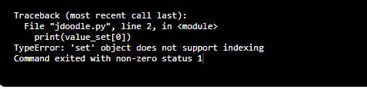
Predict the output
value_set = {2, 6, 9}
print(value_set[0])
Output
Error
Notes:
You cannot access items in a set by referring to an index, since sets are unordered the items has no index.

Slide 6
Looping in Sets
Output
value_set = {2, 'PYTHON', 'a', 5, 9.4}
for i in value_set:
print (i)
2
5
a
9.4
PYTHON
Notes:
you can loop through the set items using a for loop, or ask if a specified value is present in a set, by using the in keyword.

Slide 7
Predict the output
Output
value_set = {2, 'PYTHON', 'a', 5, 9.4}
print (7 in value_set)
False
Notes:
you can loop through the set items using a for loop, or ask if a specified value is present in a set, by using the in keyword.

Slide 8
Predict the output
Output
value_set = {2, 'PYTHON', 'a', 5, 9.4}
print ('PYTHON' in value_set)
True
Notes:
you can loop through the set items using a for loop, or ask if a specified value is present in a set, by using the in keyword.

Slide 9
Add Element
Output
value_set = {2, 'PYTHON', 'a', 5, 9.4}
value_set.add("apple")
print (value_set)
{2, 'a', 5, 9.4, 'apple', 'PYTHON'}

Slide 10
Get the length of a Set
Output
value_set = {2, 'PYTHON', 'a', 5, 9.4}
print (len(value_set))
5

Slide 11
Remove Element
Output
value_set = {2, 'PYTHON', 'a', 5, 9.4}
value_set.remove('PYTHON')
print (value_set)
{2, 5, 9.4, 'a'}
{2, 5, 9.4, 'a'}
value_set = {2, 'PYTHON', 'a', 5, 9.4}
value_set.discard('PYTHON')
print (value_set)
Difference b/w discard() and remove??

Slide 12
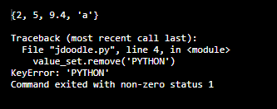
Remove Element
Output
value_set = {2, 'PYTHON', 'a', 5, 9.4}
value_set.remove('PYTHON')
print (value_set)
value_set.remove('PYTHON')
print (value_set)
value_set = {2, 'PYTHON', 'a', 5, 9.4}
value_set.discard('PYTHON')
print (value_set)
value_set.discard('PYTHON')
print (value_set)
{2, 5, 9.4, 'a'}
{2, 5, 9.4, 'a'}
{2, 5, 9.4, 'a'}
Error
Notes:
If the item to remove does not exist, remove() will raise an error.
If the item to remove does not exist, discard() will NOT raise an error.
You can also use the pop(), method to remove an item, but this method will remove the last item. Remember that sets are unordered, so you will not know what item that gets removed.
thisset = {"apple", "banana", "cherry"} x = thisset.pop() print(x) print(thisset)
Output:
Apple
{‘banana’, ‘cherry’}

Slide 13
Clear a set
Output
value_set = {2, 'PYTHON', 'a', 5, 9.4}
value_set.clear()
print(value_set)
set()

Slide 14
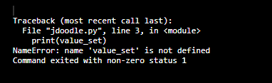
Delete the set
Output
value_set = {2, 'PYTHON', 'a', 5, 9.4}
del value_set
print(value_set)
Error

Slide 15
Union of two sets
month1_set = {"Jan", "Feb", "Dec", "Mar"}
month2_set = {"May", "Jan", "Oct", "Mar"}
print(month1_set | month2_set)
Output
{'Feb', 'May', 'Dec', 'Oct', 'Mar', 'Jan'}

Slide 16
Union of two sets
month1_set = {"Jan", "Feb", "Dec", "Mar"}
month2_set = {"May", "Jan", "Oct", "Mar"}
print(month1_set.union(month2_set))
Output
{'Oct', 'Feb', 'May', 'Jan', 'Mar', 'Dec'}

Slide 17
Intersection of two sets
month1_set = {"Jan", "Feb", "Dec", "Mar"}
month2_set = {"May", "Jan", "Oct", "Mar"}
print(month1_set.intersection(month2_set))
Output
{'Jan', 'Mar'}

Slide 18
Intersection of two sets
month1_set = {"Jan", "Feb", "Dec", "Mar"}
month2_set = {"May", "Jan", "Oct", "Mar"}
print(month1_set & month2_set)
Output
{'Jan', 'Mar'}

Slide 19
Difference of two sets
month1_set = {"Jan", "Feb", "Dec", "Mar"}
month2_set = {"May", "Jan", "Oct", "Mar"}
print(month1_set - month2_set)
Output
{'Feb', 'Dec'}

Slide 20
Difference of two sets
month1_set = {"Jan", "Feb", "Dec", "Mar"}
month2_set = {"May", "Jan", "Oct", "Mar"}
print(month1_set .difference(month2_set))
Output
{'Feb', 'Dec'}

Slide 21
Set Comparisons
month1_set = {"Jan", "Feb", "Dec", "Mar"}
month2_set = {"Jan", "Feb"}
print (month1_set > month2_set)
print (month1_set < month2_set)
print (month1_set == month2_set)
Output
True
False
False
Notes:
#month1 is the superset of month2 hence it will print true.
#prints false since month1 is not the subset of month2
#prints false since month1 and month2 are not equivalent

Slide 22
Frozen Sets
Immutable
No duplicate elements
Contain the keys of dictionary(Will see later)
Example:
s = frozenset([6, ‘python’, 5.6])
Notes:
Title + Image + Text

Slide 23
Creating Frozen Sets
s = frozenset([6, 'python', 5.6])
print(s)
Output
frozenset({'python', 5.6, 6})
Notes:
Title + Image + Text

Slide 24
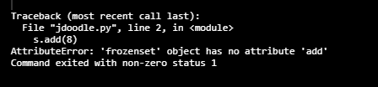
Predict the output
Output
s = frozenset([6, 'python', 5.6])
s.add(8)
print(s)
Error
Notes:
Title + Image + Text

Slide 25
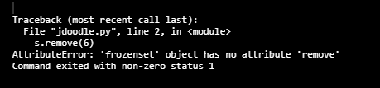
Predict the output
Output
s = frozenset([6, 'python', 5.6])
s.remove(6)
print(s)
Error
Notes:
Title + Image + Text

